Slide 1
NE 591: Advanced Reactor Materials
Fall 2021
Dr. Benjamin Beeler

Slide 2
supercritical water cooled reactors

Slide 3
Supercritical Water Reactor (SCWR)
Similar to a traditional light water reactor, but operates at a supercritical pressure
Water heated in the core becomes a supercritical fluid, which can directly be used in a steam turbine
Removes the added step of a heat exchanger, increasing the efficiency of the reactor system

Slide 4
Supercritical water
A supercritical fluid is a substance with a temperature and pressure above its critical point
At such a point, distinct solid and liquid phases do not exist
Critical point of water is 22 MPa and 647 K
Density is highly variable, based on temperature and pressure:
0.78 g/cc @ 25 MPa and 280 C
0.09 g/cc @ 25 MPa and 500 C
these are reasonable inlet/outlet temperatures for SCWR coolant

Slide 5
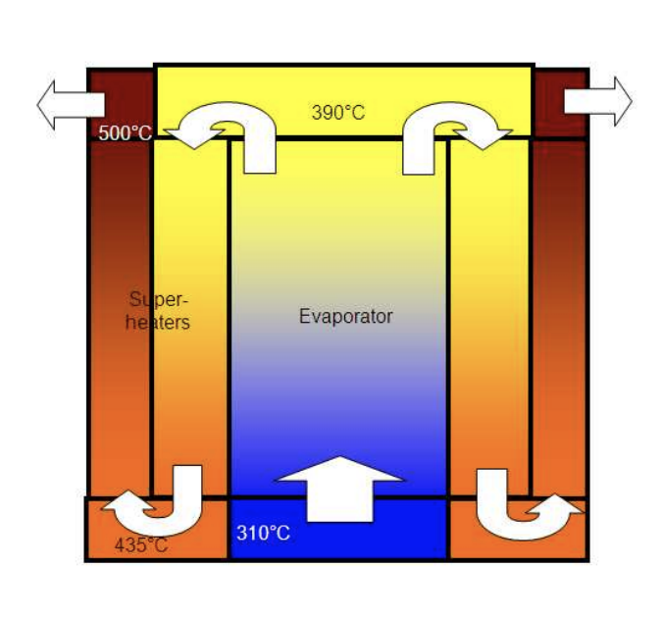
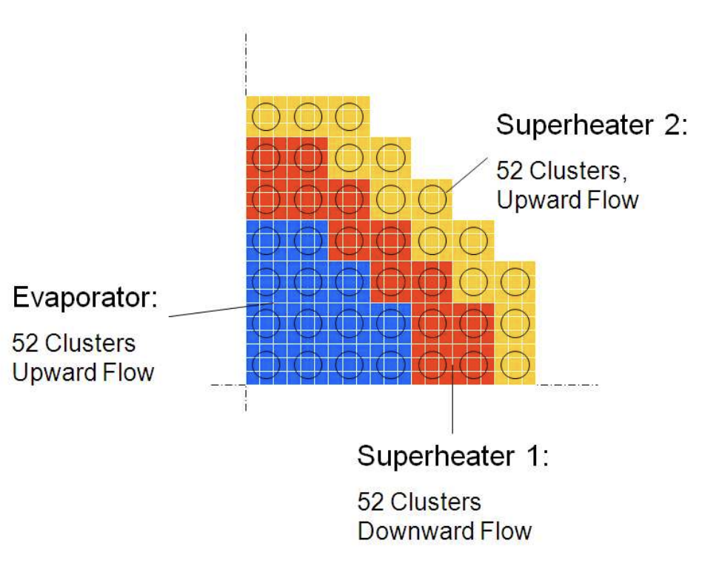
Comparison to LWR
SCWR
coolant in: 280 C
coolant out: 600 C
outlet specific enthalpy: 3150 kJ/kg
three pass coolant
coolant pressure: 25 MPa
LWR
coolant in: 275 C
coolant out: 315 C
outlet specific enthalpy: 200 kJ/kg
one pass coolant
coolant pressure: 15 MPa

Slide 6
Features
Supercritical water has excellent heat transfer properties allowing a high power density, a small core, and a small containment structure
The use of a supercritical Rankine cycle with its typically higher temperatures improves efficiency (would be ~45 % versus ~33 % of current PWR/BWRs)
This higher efficiency would lead to better fuel economy and a lighter fuel load, lessening residual (decay) heat
SCWR is typically designed as a direct-cycle, whereby steam or hot supercritical water from the core is used directly in a steam turbine with no intermediate heat exchangers, etc
SCWRs can operate as a fast breeder, or utilize heavy water and the thorium fuel cycle
Disadvantages include operating at very high temperatures and pressures, increasing material challenges
The economic advantage of a direct cycle is a downside with regard to safety, in that a cladding breach means your turbine and generators are directly exposed to radioactivity
Corrosion in SCW is a challenge

Slide 7
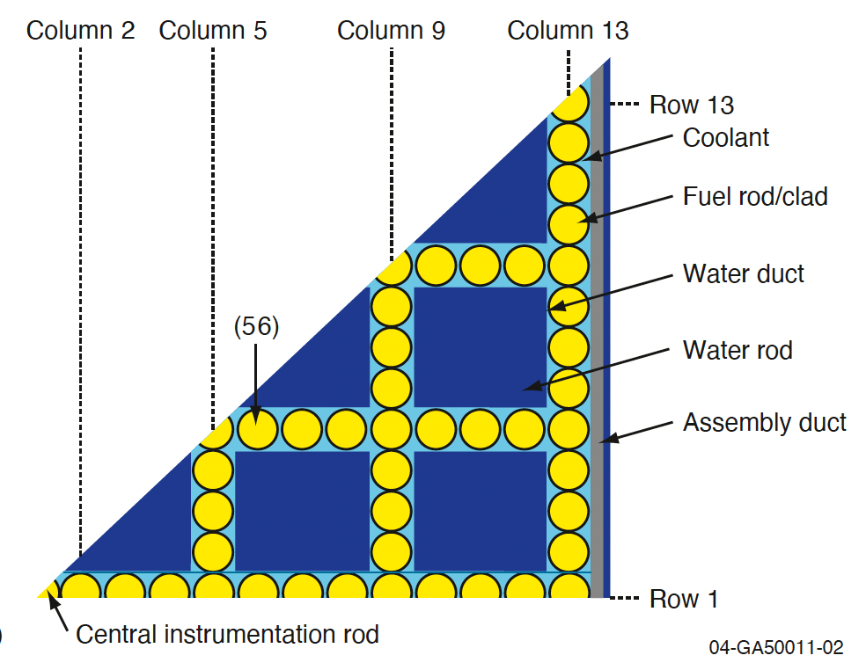
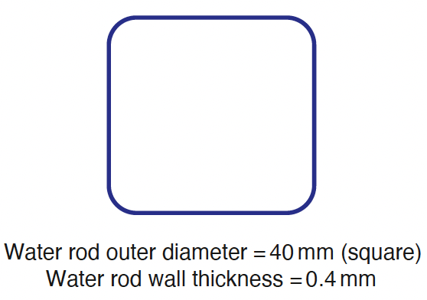
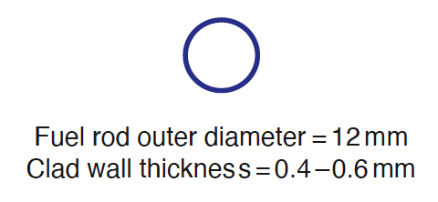
SCW geometry
There is experience in SCW cycles in the fossil fuel industry, however they are able to use thick-walled geometries that are not feasible in nuclear designs
1/8 assembly model SCWR core

Slide 8
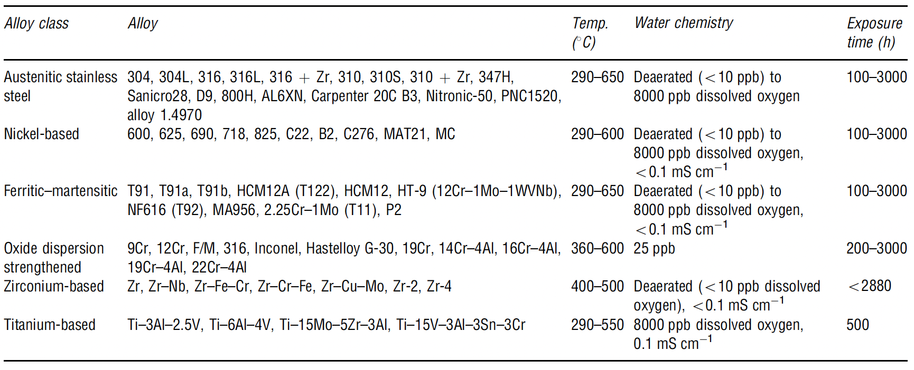
Corrosion
These very thin-walled components provide little margin for corrosion in an SCWR core, where the consequences of failure are significant
Oxide films and deposition of corrosion products from out-of-core components can lead to overheating (and failure) and changes in reactivity
SCW corrosion studies have included F/M steels, austenitic steels, Ni alloys, Zr alloys and Ti alloys

Slide 9
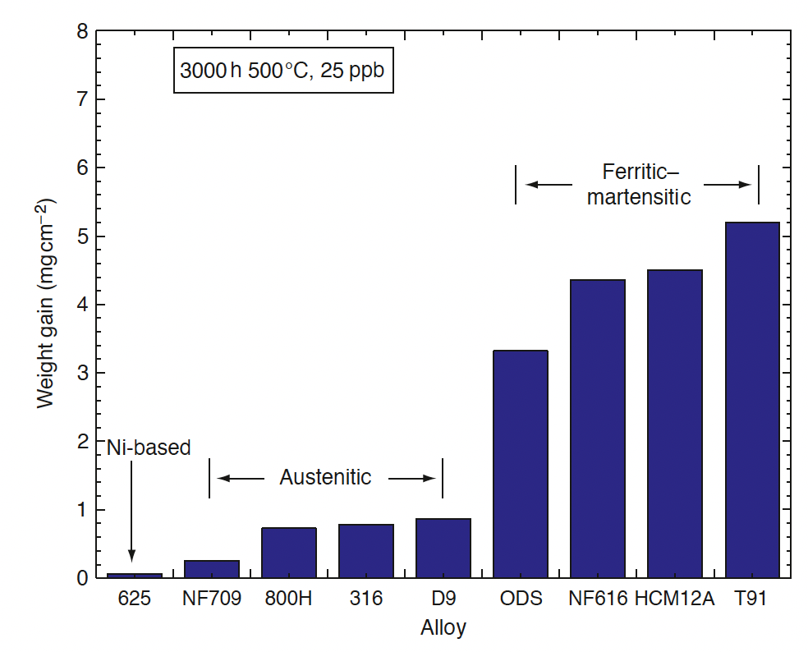
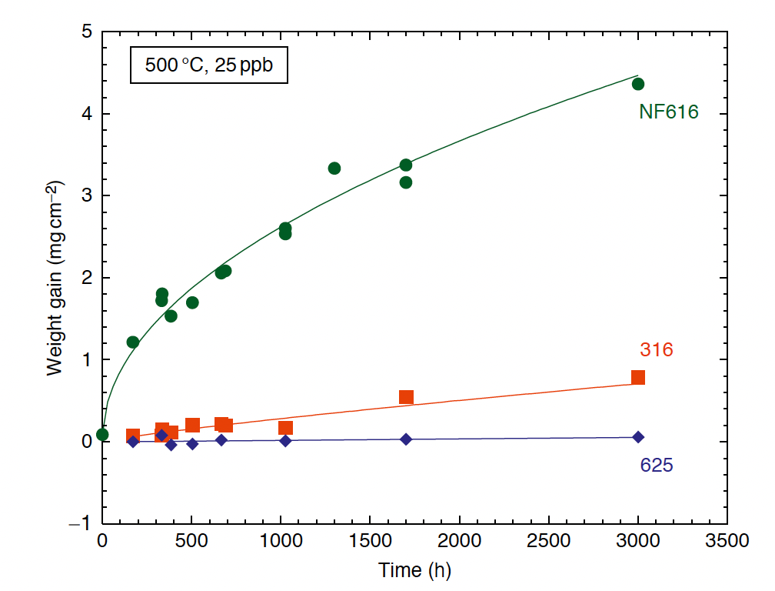
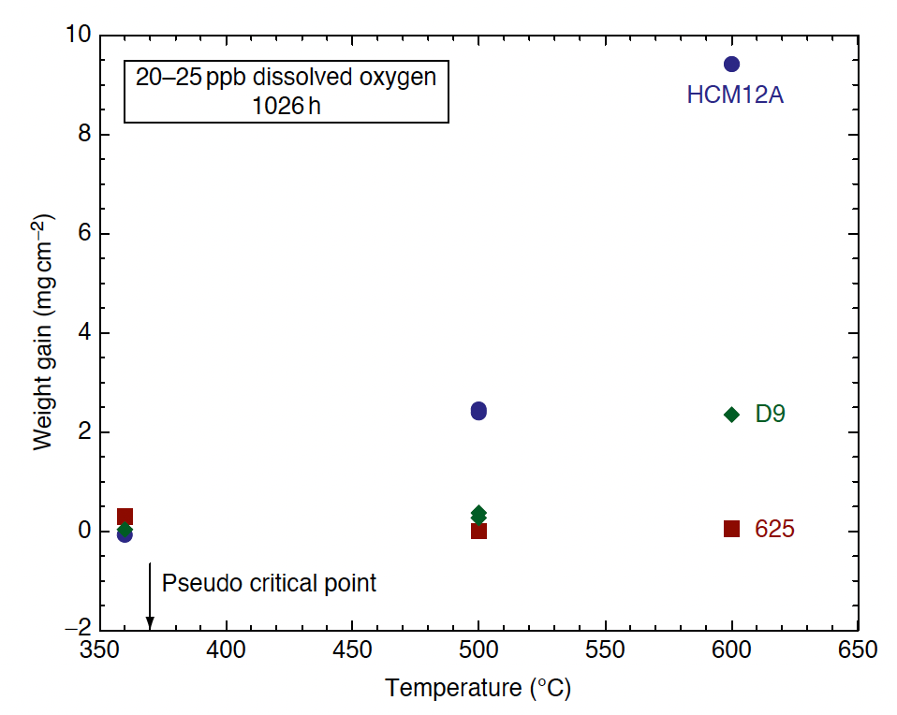
Alloy Classes
Corrosion is strongly dependent upon the alloy class
Oxidation is most rapid for F/M steels and slowest for Ni alloys
Temperature has a very strong effect on corrosion
Dissolved O content 25 ppb
NF616 = F/M
316 = aust.
625 = Ni
HCM12A = F/M
D9 = aust.
625 = Ni

Slide 10
Stress Corrosion Cracking
Austenitic stainless steels and nickel-based alloys exhibit susceptibility to IGSCC in pure SCW over the temperature range of 400–650C
IGSCC decreases with temperature, but overall fracture increases with temperature
Small additions of HCl or H2SO4 increase susceptibility to IGSCC in austenitic alloys
Ni based alloys are more susceptible to SCC than austenitic steels
Higher Cr content in Ni alloys seems to reduce the extent of SCC
F/M alloys are generally resistant to SCC (HT-9 is an exception)
Irradiation strongly exacerbates SCC, but the effect decreases with increasing temperature

Slide 11
Lead Cooled reactors

Slide 12
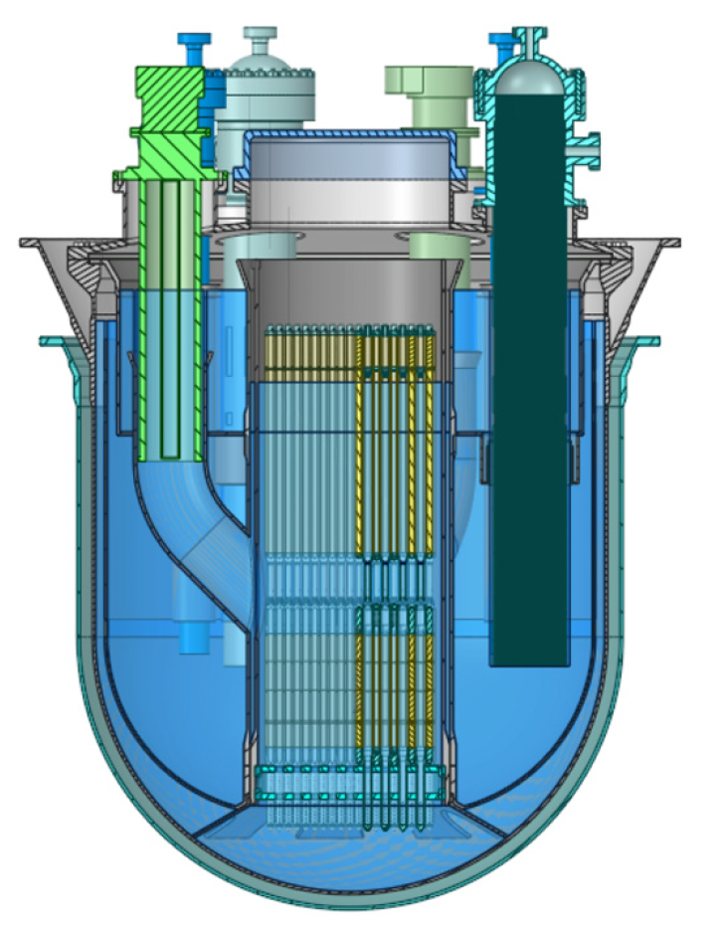
ALFRED Reactor
ALFRED, the advanced lead-cooled fast reactor European demonstrator
ALFRED is today a demonstrator reactor designed with the specific purpose to test and qualify innovative components and procedures to be used in commercial reactors
Pool type, MOX hollowed fuel pellets, natural and forced circulation
Planned commercial operation in 2035-2040

Slide 13
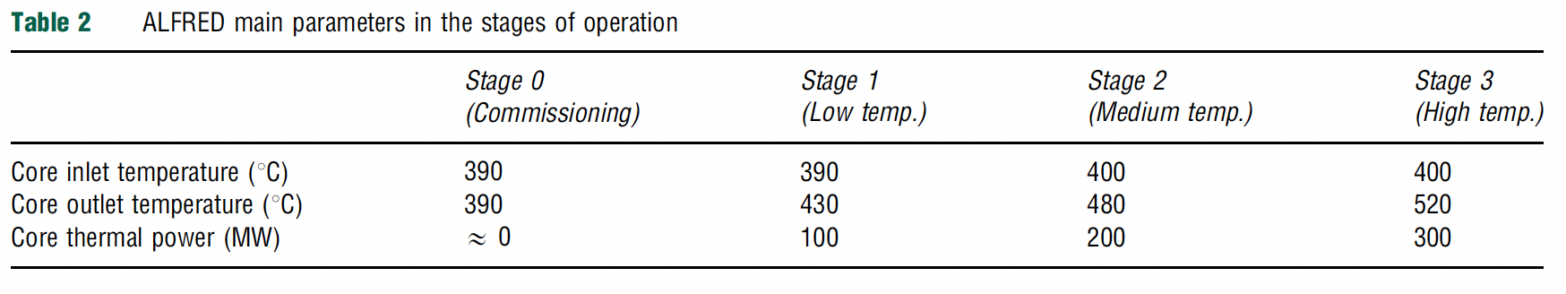
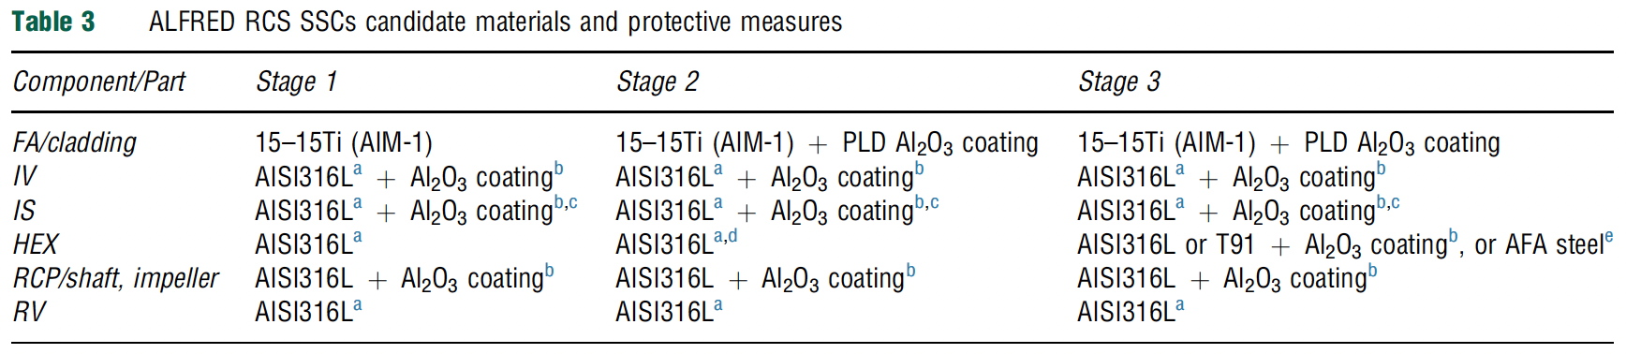
ALFRED Reactor
ALFRED plans to operate in a staged manner for licensing purposes, ramping up activities
Currently planned materials are listed for the different stages, relying heavily on coatings and austenitic steels
An example 15-15Ti steel in the US is D9
Different reactor concepts with different candidate materials

Slide 14
Lead Corrosion
The challenge of using heavy liquid metal coolant (lead and lead-bismuth) is the compatibility with structural materials at high temperature
Pb and lead-bismuth eutectic (LBE) provide highly corrosion conditions for most structural and cladding materials
This is most problematic for thin-walled components such as cladding tubes or heat exchangers
Corrosion in Pb and LBE is due to the dissolution of different constituent elements, their transport, and their chemical reactions with oxygen and nitrogen

Slide 15
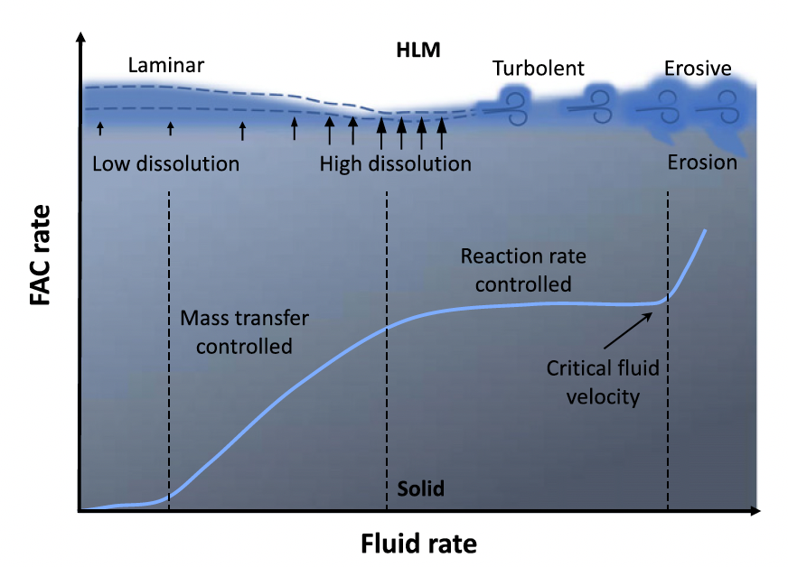
Flow Accelerated Corrosion
At low flow velocity, the corrosion is controlled by mass transfer, that is by diffusion of dissolved elements in the boundary layer
When the flow velocity increases, the thickness of the laminar boundary layer decreases, leading to an increase of the corrosion rate; the enhanced flow velocity locally reduces the corrosion product concentration at the interface, further promoting the diffusion process in the boundary layer

Slide 16
Flow Accelerated Corrosion
When the velocity is high enough to “clean” the surface of the solid metal from the corrosion products, the corrosion becomes flow-independent and therefore it is considered reaction rate controlled
At higher flow velocities, above a critical value, erosion-corrosion and also cavitation-corrosion may occur, leading to a significant increase of the corrosion rate

Slide 17
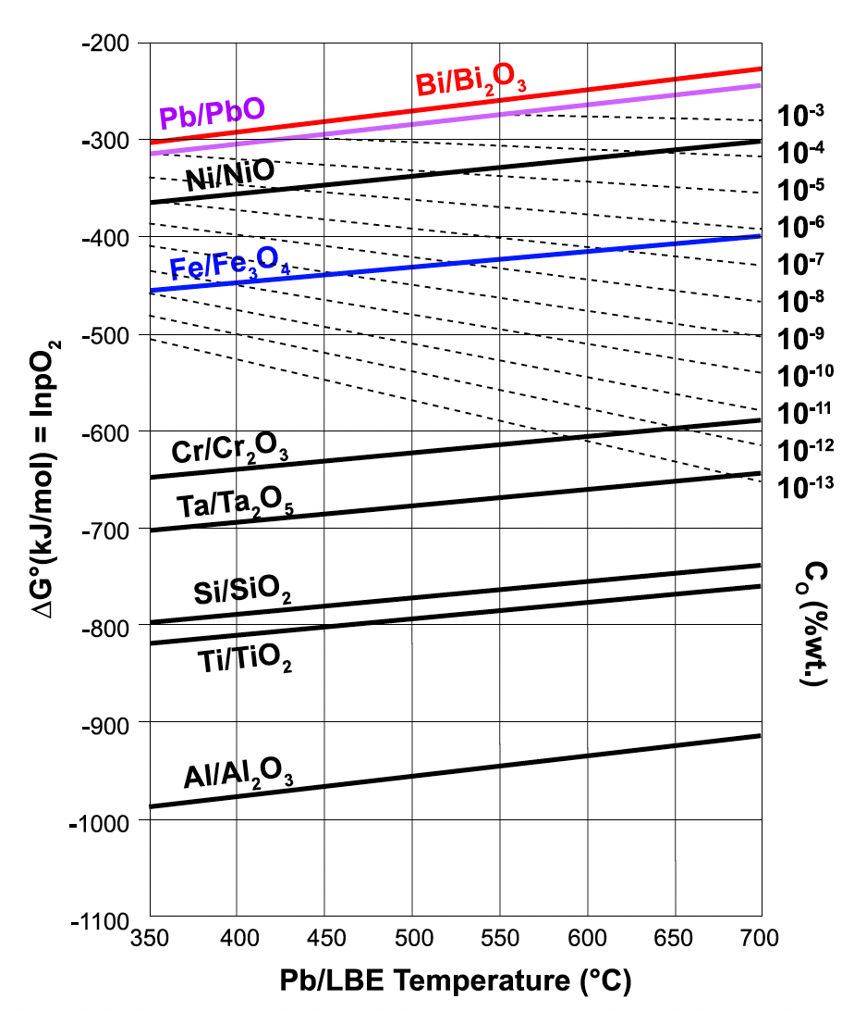
Impurities
A factor that has a considerable effect on the corrosion rate processes is the presence of nonmetallic impurities such as carbon, nitrogen, and oxygen
Impurity elements can take part in corrosion reactions and can form compounds with dissolved species
Oxides of the steel components are more stable than the LBE, and thus a Fe-Cr oxide layer on steel surfaces

Slide 18
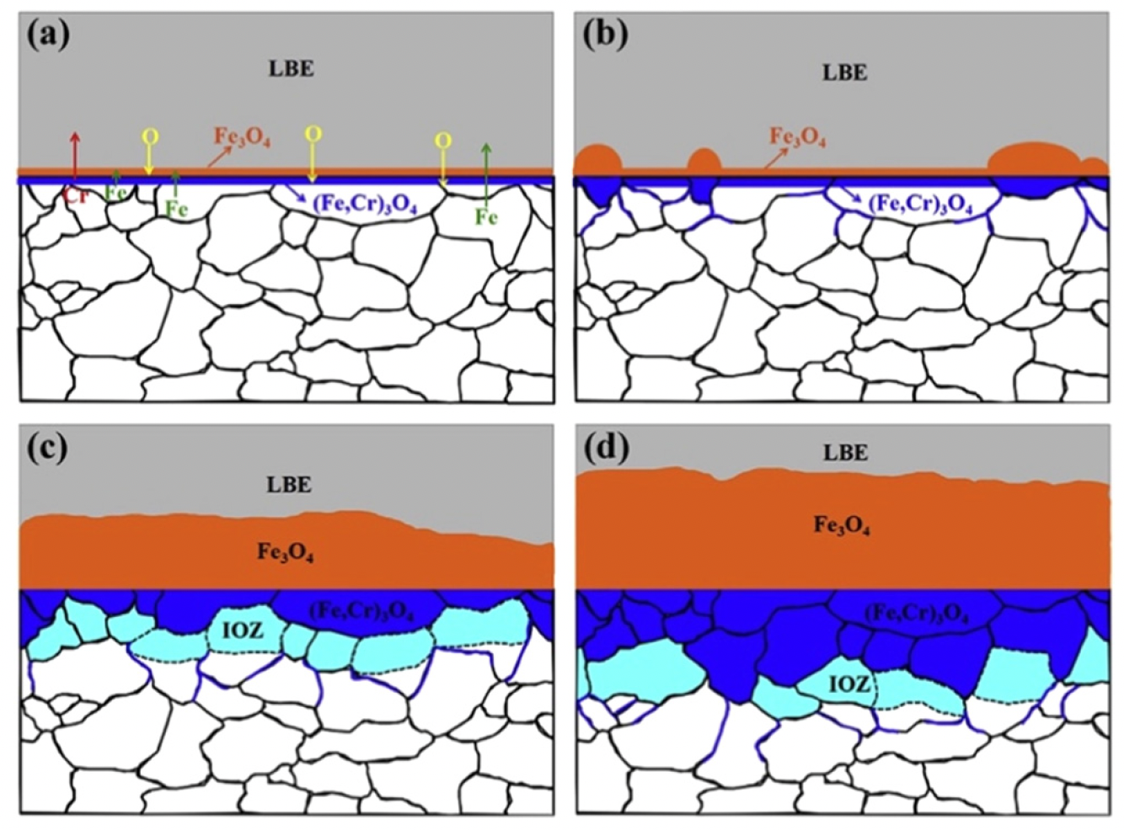
Oxide Passivation
Adequate control of the oxygen concentration allows one to maintain the Fe-Cr oxide film, without oxidizing the LBE
If insufficient oxygen is present, the steel will suffer dissolution corrosion
The oxide layer can form as a multi-layered structure dependent upon O content, temperature, and flow, with Fe3O4 and FeCrO2 phases

Slide 19
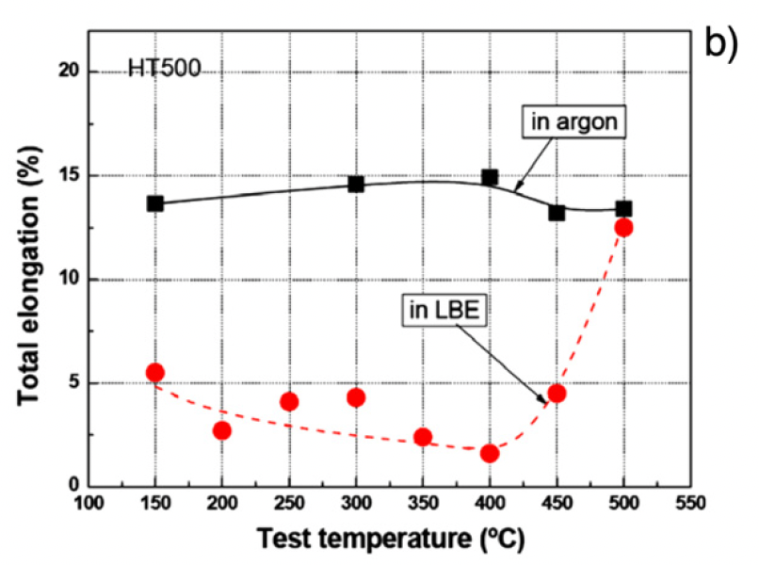
Mechanical Property Effects
Liquid metal embrittlement (LME) is a known phenomenon, but its mechanism is not fully understood
Contact with LM causes a decrease in ductility, resulting in a premature brittle failure in an otherwise ductile material
LME occurs by nucleation of a crack at the wetted surface of a solid and the subsequent propagation into the bulk until ultimate failure

Slide 20
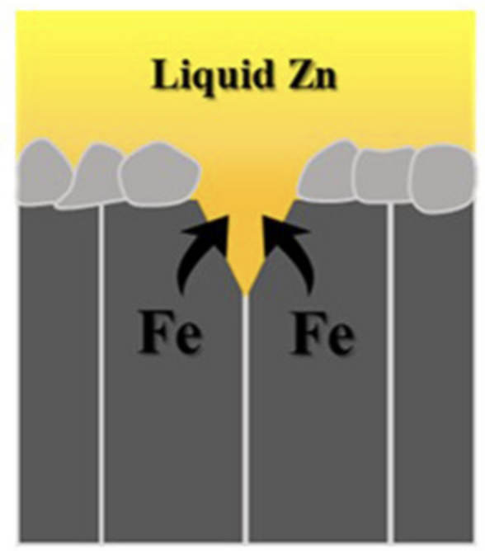
LME
The loss of ductility of solid metals when in contact with liquid metal appears to be limited to a particular temperature range known as the ductility trough
For the F/M T91 steel in liquid lead, a ductility trough between 160C and 425C was found
The ductility trough is detected by following the evolution of the ultimate tensile stress or energy to rupture with temperature
The working theory on LME is based on a reduction of the surface energy by absorption of liquid metal atoms at the crack tip of the solid

Slide 21
Composite fuels

Slide 22
Composite Fuels
Composite fuels consist of a fissile phase dispersed in an inert, nonfuel matrix
These types of fuels have been used since the 1950s in high-temperature and high-power density applications
Composite fuels are typically distinguished into two types: Cermet and Cercer
Cermet: ceramic fuel particles dispersed in a metallic matrix
Cercer: ceramic fuel particles in a ceramic matrix
47 different fuel matrix combinations have been experimentally explored
Composite fuels have potential as high burnup fuels to either transmute transuranic elements, or to replace conventional UO2 fuel pellets

Slide 23
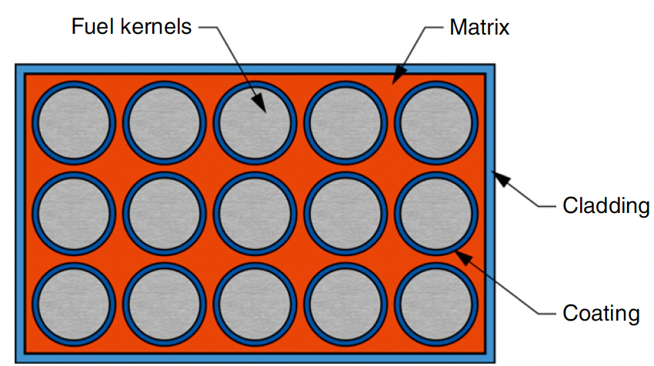
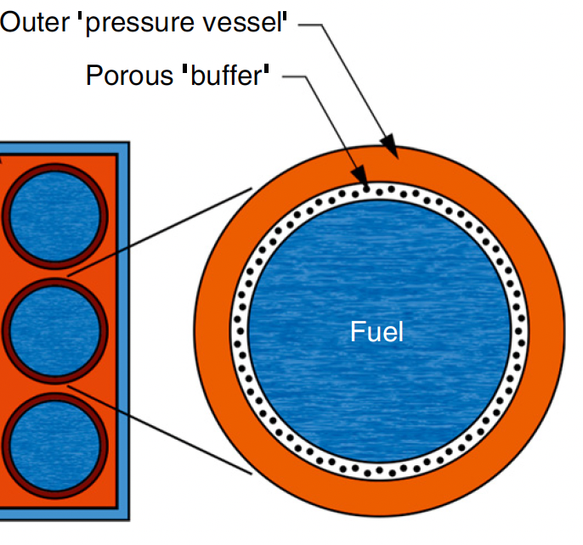
Composite Fuels
The most complete experimental work focused on UO2 particles dispersed in stainless steel
The primary feature that distinguishes composite fuels from the pellet-in-cladding fuel types is the localization of fuel material within an inert matrix
Fuel particles can be individually clad within the matrix material by an individual coating

Slide 24
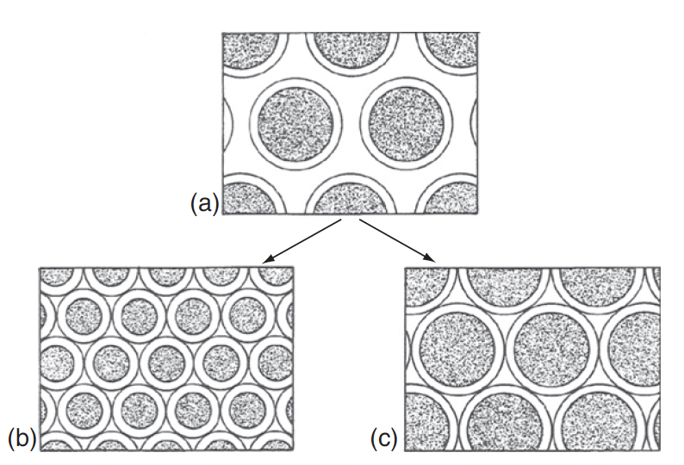
Cermet Fuel
The performance of the Cermet fuel depends on the ability of the matrix to retain strength and ductility during irradiation
The strength of the matrix must be sufficient to resist cracking from stresses due to solid fission products and fission gas swelling
The major source of matrix degradation is the fission fragments ejected from the fuel
The distance between (or density) of fuel particles must be sufficient such that the damage region around a given particle does not overlap with an adjacent particle

Slide 25
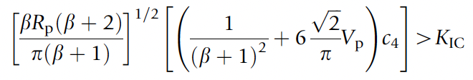
Cercer Fuel
The typical failure mode in cercer fuels is fuel particle swelling that leads to a tensile stress in the matrix, followed by matrix cracking
Models have been constructed to predict failure taken from thermal expansion in duplex ceramics
Increasing the interparticle distance, decreasing the particle size, decreasing fuel swelling and thermal expansion, etc., reduce the probability of fracture of the matrix

Slide 26
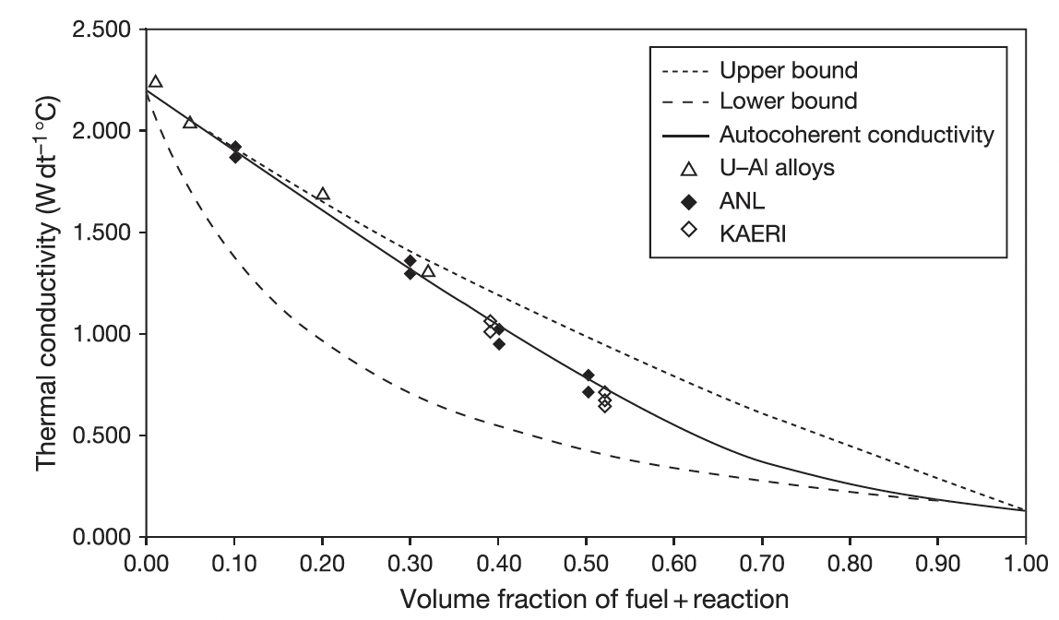
Composite Thermal Conductivity
The behavior of composite fuels can be heavily influenced by fuel operating temperature, and thermal conductivity is of primary importance in the irradiation behavior of these fuels
Fuel particle size, shape, orientation, and distribution, and matrix porosity and the thermal conductivities of the fuel and matrix species are the key properties of interest

Slide 27
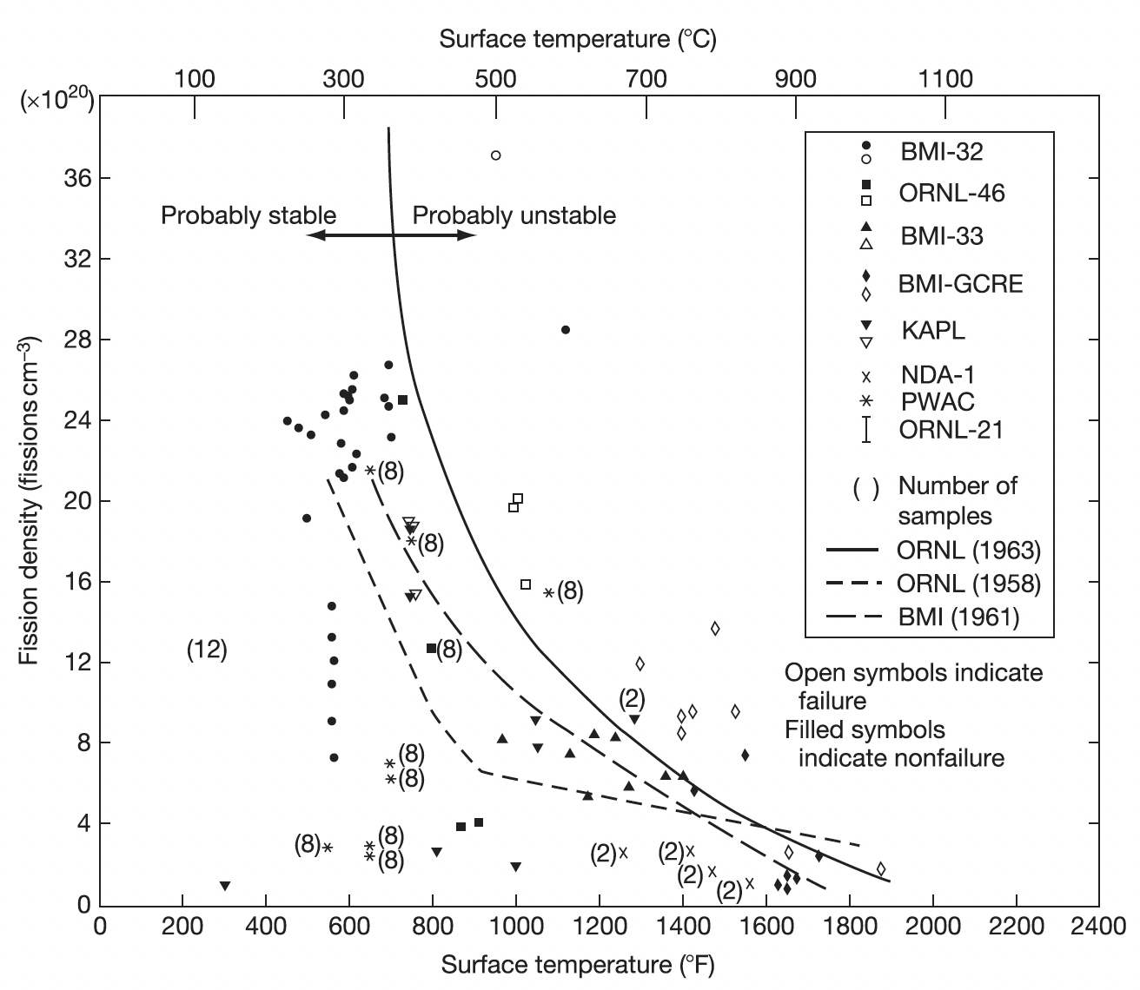
Irradiation Behavior
Most irradiation information is on UO2 dispersed in stainless steel
Full-size 20vol% plate-type elements reached 65 at% burnup at surface temperatures of 315–427C with no blistering or cracking
There are bounding limits on fission density (+ loading) and surface temperature
Higher matrix loadings are possible, but are restricted to low (<15%) burnups

Slide 28
Particle fuels

Slide 29
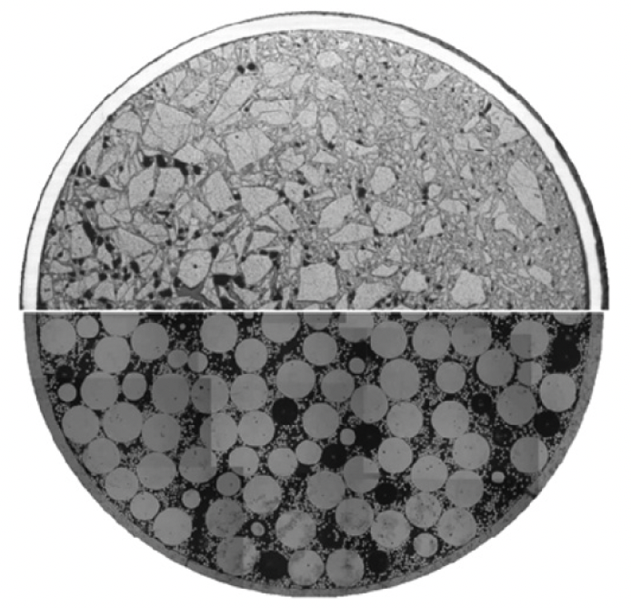
Particle Fuels
Vipac
When the fissile isotopes are coming from spent fuel that is chemically separated (reprocessed), particle fuel with its direct filling of fuel particles into the fuel pin offers several advantages
Two major types of particle fuel are sphere-pac and Vipac
sphere-pac

Slide 30
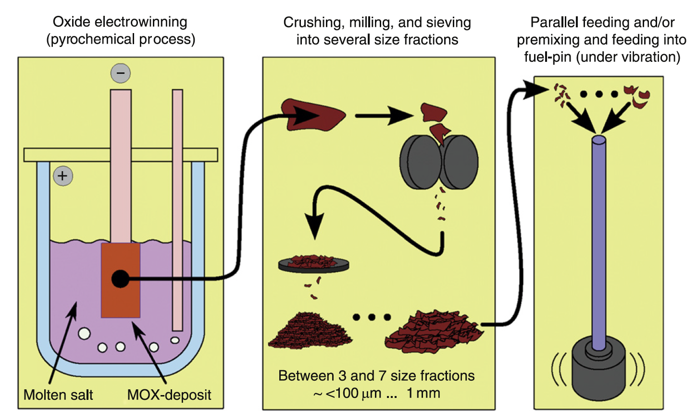
Vipac
The usage of randomly shaped (angular shards) particles as nuclear fuel component filled in a cladding goes back to the 1950s
Reprocessing of fuel from the BOR-60 reactor was pursued to developed fuel for the BN-600 reactor – MOX fueled fast reactors
These particles are fed into the cladding under vibration
Vibration packing = Vipac

Slide 31
Sphere-Pac
Sphere-pac fuel is also composed of particles which are directly filled into a fuel pin
However, particles are shaped into spheres to generate a more predictable arrangement of particles in the fuel pin
Sphere-pac is used in conjunction with the PUREX process, combined with follow-up processes such as actinide extraction
A fully aqueous method offers excellent distribution of the fissile material in the matrix and the formation of solid solution in the ceramic
This also eliminates the need for mechanical devices, reduces powder generation, and thus minimizes contamination

Slide 32
Particle Fuels
This modified geometry of fuel will present important changes in the fuel properties as a unit
The thermal conductivity is reduced, which increases the centerline temperature, and can lead to restructuring
The fuel is softer because of the void space, reducing FCMI
Significantly higher fission gas release, due to the prevalence of free surfaces
In the case of a cladding breach, this increased fuel surface area provides greater opportunity for coolant reaction with the fuel
At fuel startup, fuel particles are not bonded, and in case of early life cladding breach, potential loss of fuel particles

